Slide 1

Abstraction
Acknowledgment and Disclaimer: This presentation is supported in part by the National Science Foundation under Grants 1240841, 1225680, 1225719, 1225745, 1225976, and 1226216. Any opinions, findings, and conclusions or recommendations expressed in these materials are those of the authors and do not necessarily reflect the views of the National Science Foundation.
December 19, 2013
Notes:
*

Slide 2
Abstraction, a Big Idea
• Abstraction is one of the 7 big ideas of the CS Principles Curriculum and we are going to see lots of computer science examples in this course.
• Abstracting, the process of creating abstractions, is one of the computational thinking skills in our curriculum.
But, what exactly is an abstraction and what exactly do we do when we create an abstraction?

Slide 3
Abstraction
a general representation of something
• An abstraction is a general representation of something -- of some person or place or event or process.
• Abstractions are formed by including only those details needed to make the abstraction useful to us in some way.
• You use abstractions all the time, although you probably don’t call them that. You couldn’t think or speak without them.
• Words, ideas, concepts, maps, models, symbols -- these are all examples of abstractions that we use every day to think about and talk about the world.

Slide 4
Some Everyday Examples of Abstractions
December 19, 2013
Notes:
*

Slide 5
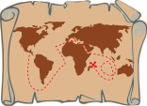
A map is an abstraction
Abstraction: A map contains less information than the world that it represents.
Abstracting: We create a map by including only those details that will help us achieve the purpose of drawing the map.

Slide 6
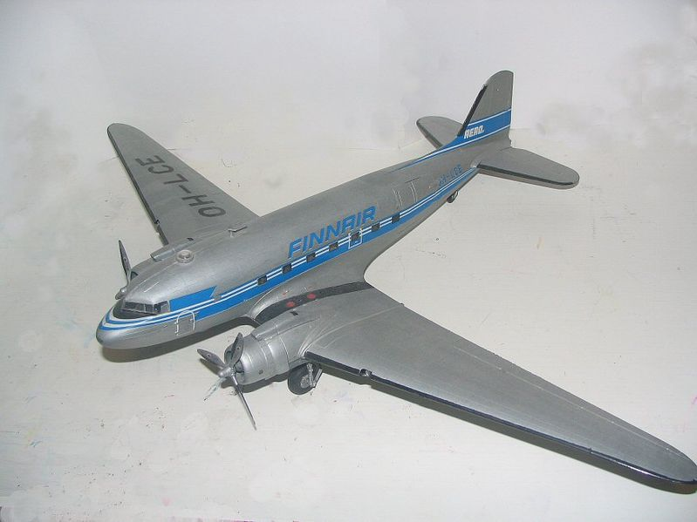
A model is an abstraction
Abstraction: A model airplane contains less information than the real airplane it represents.
Abstracting: We create a model airplane by including only those features of the plane that make the model useful for our purposes.

Slide 7
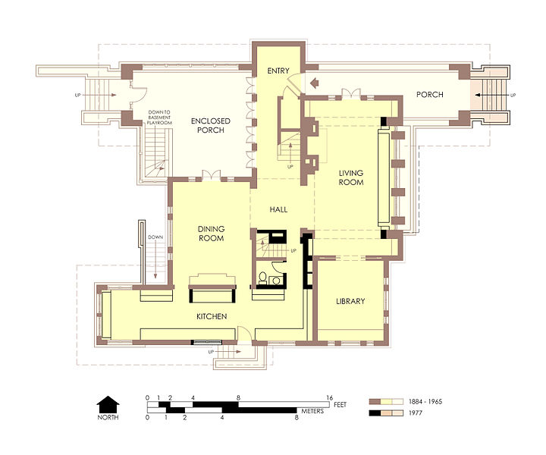
A floor plan is an abstraction
Abstraction: A floor plan contains less information than the real space it represents.
Abstracting: We create a floor plan by including only those spatial features that are relevant to why we are making the plan.

Slide 8
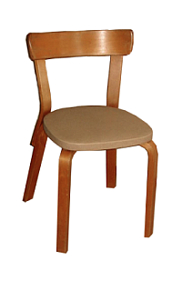

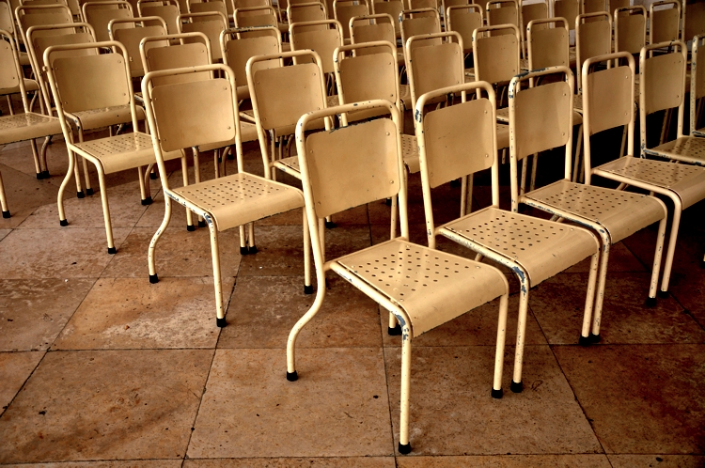
Ideas and concepts are abstractions
Our ideas and concepts are abstractions are formed through a process of leaving out details of the specific things that the idea represents. For example, our concept of chair is general enough to represent any and all chairs.
Abstraction: An idea or concept is a general representation of something
Abstracting: Thinking in abstractions is a fundamental part of human behavior.

Slide 9
Words and other symbols are abstractions
‘chair’
Some of the most abstract examples of abstractions are the words we use in our everyday language. Unlike maps and models and floor plans, which have some visible similarities with the objects they represent, a word is completely abstract.
Abstraction: A word contains almost no specific information about the objects it represents other than their definition.
Abstracting: Learning that words represent things is a fundamental skill in learning to speak and read.

Slide 10
Abstraction in Computer Science
December 19, 2013
Notes:
*

Slide 11
Simplifying, condensing, encapsulating
• In computer science, the process of simplifying, condensing, and encapsulating is an important problem solving skill.
• Abstractions in hardware and software help to reduce complexity and make computer systems easier to use and understand.

Slide 12
A variable is an abstraction
Computer languages contain constants and variables, both of which are abstractions.
A constant, such as the numeral 5 represents only one thing, the value 5.
A variable, such as the symbol ‘X’, can represent any number.
Abstracting: We use variables to make our programs more general and more useful.

Slide 13
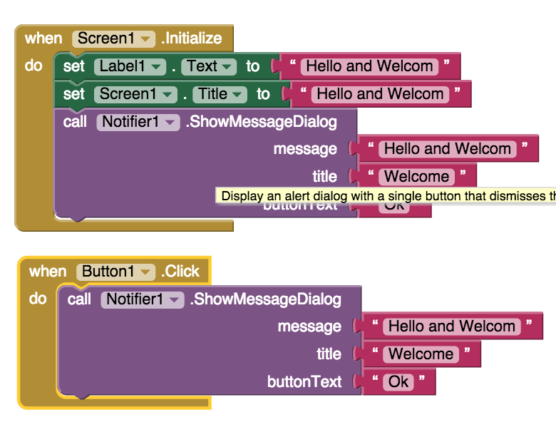
Data Abstraction Example
Notice all the occurrences of the same literal text. This is data that was copied-and-pasted

Slide 14
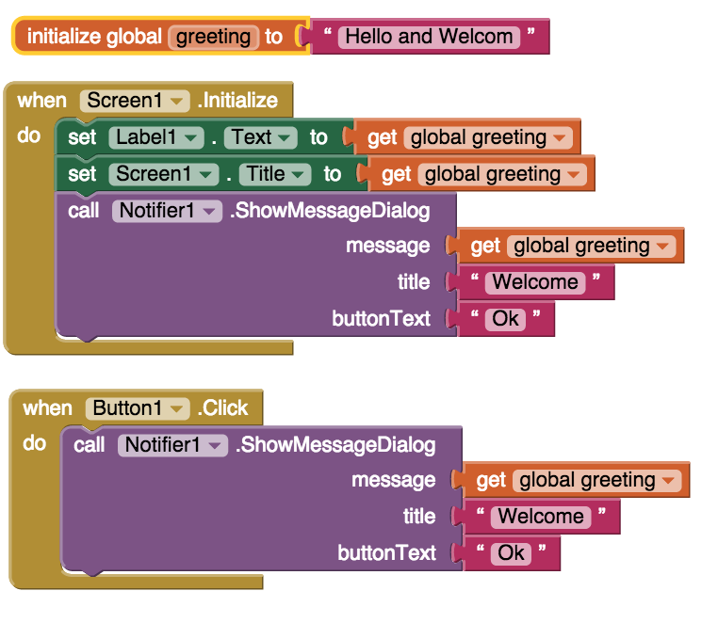
Data Abstraction Example
In this version we’ve replaced the literal occurrences with the greeting variable.

Slide 15
Data Abstraction Example
In this version we’ve replaced the literal occurrences with the greeting variable.
Which version of this program is easier to debug and maintain?

Slide 16
A procedure is an abstraction
Computer languages have procedures that perform certain calculations for us.
The sqrt(x) procedure calculates the square root of any number, x. For example, the sqrt(5) is 2.236.
Abstraction: The sqrt() procedure simplifies the process of calculating a square root. We don’t need to know exactly how it is done.
Abstracting: We will create procedures to make our programs easier to use and understand.

Slide 17
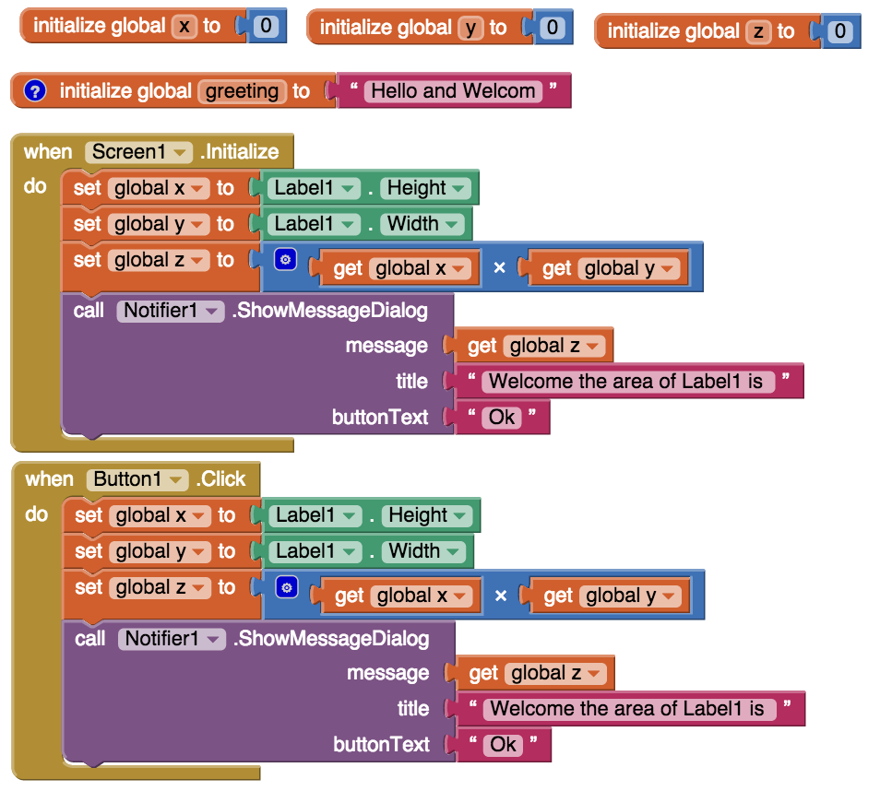
Procedural Abstraction Example
Notice this algorithm that is done twice?
Can you tell what it’s doing?

Slide 18
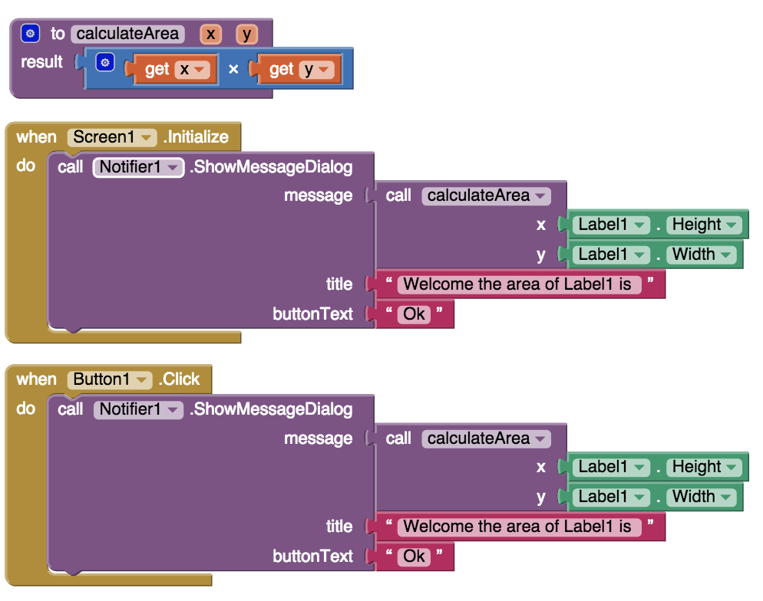
Procedural Abstraction Example
In this example we’ve abstracted the algorithm into a procedure that we call whenever we want to calculate area.

Slide 19
Procedural Abstraction Example
In this example we’ve abstracted the algorithm into a procedure that we call whenever we want to calculate area.
Which version of this program is easier to debug and maintain?

Slide 20
So, to summarize
• An abstraction is a general and simplified representation of something. Words, symbols, maps, and models are examples.
• Abstracting is the process of removing details and condensing information in order to focus on relevant aspects of the object or objects we are representing.

